Slide 1
Artificial Intelligence: Representation and Problem Solving Optimization (1): Optimization and Convex Optimization
15-381 / 681
Instructors: Fei Fang (This Lecture) and Dave Touretzky
feifang@cmu.edu
Wean Hall 4126

Slide 2
Logistics
Complete the CMU 'course hours worked' survey

Slide 3
Recap
What we have learned so far…
Search & Satisfiability in discrete space
8-queen, Graph coloring, 3-SAT,…
Finite options
This section: Generalize to discrete / continuous space
Notes:
Properties
Finite options (brute force when the problem scale is small)
(Often) NP-Complete
Solution approach
Brute force when the problem scale is small

Slide 4
Outline
Optimization
Convex Optimization

Slide 5
Optimization Problem: Definition
Optimization Problem: Determine value of optimization variable within feasible region/set to optimize optimization objective
Optimization variable $x∈ℝ^{n}$
Feasible region/set $ℱ⊂ℝ^{n}$
Optimization objective $f:ℱ→ℝ$
Optimal solution: $x^{∗}=\underset{x∈ℱ}{argmin}{f(x})$
Optimal objective value $f^{∗}=\min_{x∈ℱ}{f(x})=f(x^{∗})$
$$\min_{x}{f(x)}$$
s.t. $x∈ℱ$
Notes:
X: vector with n real-valued entries
Many important problems are about choosing a best configuration or a set of parameters to achieve some goal.
f: F-> R^1
Optimal solution: Best value of optimization variables
Optimal value: Best value of optimization objective

Slide 6
Optimization Problem: Definition
$$\min_{x}{f(x)}$$
s.t. $x∈ℱ$
Optimization variable $x∈ℝ^{n}$
Discrete variables: Combinatorial optimization
Continuous variables: Continuous optimization
Mixed: Some variables are discrete, and some are continuous
Notes:
Can be discrete or continuous valued variables or mixed
Example: shopping with given budget
Shortest path, Traveling salesman problem

Slide 7
Optimization Problem: Definition
$$\min_{x}{f(x)}$$
s.t. $x∈ℱ$
$\text{Feasible} \text{region}\text{/}\text{set} ℱ⊂ℝ^{n}$
Unconstrained optimization: $ℱ=ℝ^{n}$
Constrained optimization: $ℱ⊊ℝ^{n}$
Find a feasible point $x∈ℱ$ can already be difficult
Notes:
Example: shopping with given budget
Shortest path, Traveling salesman problem

Slide 8
Optimization Problem: Definition
$$\min_{x}{f(x)}$$
s.t. $x∈ℱ$
Optimization objective $f:ℱ→ℝ$
$f\left(x\right)=1$: Feasibility problem
Simple functions
Linear function $f\left(x\right)=a^{T}x$
Convex function (this lecture)
Complicated functions
Even can be implicitly represented through an algorithm which takes $x∈ℱ$ as input, and outputs a value
Notes:
$f(x)$ can be as simple as a linear function
f(x) may even lack a closed form, but can only

Slide 9
Optimization Problem: Definition
$$\min_{x}{f(x)}$$
s.t. $x∈ℱ$
Minimization can be converted to maximization (and vice versa)
$$\max_{x}{g\left(x\right)=−f(x)}$$
s.t. $x∈ℱ$
Same optimal solution Optimal objective value $g^{∗}=−f^{∗}$
Notes:
Can be discrete or continuous valued variables or mixed
Example: shopping with given budget
Shortest path, Traveling salesman problem

Slide 10
Optimization Problem: Example
$$\min_{x}{f(x)}$$
s.t. $x∈ℱ$
Example: Traveling Salesman Problem (TSP)
Problem: $n$ cities, distance from city $i$ to city $j$ is $d(i,j)$, find a tour (a closed path that visits every city exactly once) with minimal total distance
Variable $x$: ordered list of cities being visited
$x_{i}$ is the index of the $i^{th}$ city being visited
Feasible set $F=\{x:\text{each} \text{city} \text{visited} \text{exactly} \text{once}\}$
$F=\{x:x∈{\left\{1..n\right\}}^{n};\sum_{k}{𝕝\left(x_{k}=i\right)}=1,∀i∈\{1..n\}\}$
Objective function $f\left(x\right)=$ $\text{total} \text{distance} \text{when} \text{following} x$
$f\left(x\right)=\sum_{k=1}^{n−1}{d\left(x_{k},x_{k+1}\right)}+d(x_{n},x_{1})$
Notes:
Combinatorial optimization problem $𝕝\left(⋅\right)$ is the indicator function

Slide 11
Optimization Problem: Example
$$\min_{x}{f(x)}$$
s.t. $x∈ℱ$
Example: 8-Queens Problem
Variable $x$: location of the queen in each column
$x_{i}$ is the row index of the queen in $i^{th}$ column
Feasible set $F=\{x:\text{no} \text{queens} \text{in} \text{the} \text{row}\text{, }\text{col}\text{, }\text{diag}\}$
$F=\{x:x∈{\left\{1..8\right\}}^{8};x_{i}≠x_{j},|x_{i}−x_{j}|≠|i−j|,∀i,j∈\{1..8\}\}$
Objective function $f\left(x\right)=1$ (dummy)
Variable $x_{i},y_{i}$: index of row and column of the $i^{th}$ queen
Feasible set $F=\{x,y:\text{no} \text{queens} \text{in} \text{the} \text{row}\text{, }\text{col}\text{, }\text{diag}\}$
$F=\{x,y:x,y∈{\left\{1..8\right\}}^{8};$ $\sum_{i}{𝕝\left(x_{i}=k\right)}=1,∀k∈\{1..8\}$; $\sum_{i}{𝕝\left(y_{i}=k\right)}=1,∀k∈\left\{1..8\right\}$;$\left|x_{i}−x_{j}\right|≠\left|y_{i}−y_{j}\right|,∀i,j∈\left\{1..8\right\}\}$
Objective function $f\left(x\right)=1$ (dummy)

Slide 12
Optimization Problem: Example
$$x_{i}$$ | $$1.0$$ | $$2.0$$ | $$3.5$$
$$y_{i}$$ | $$2.1$$ | $$3.98$$ | $$7.0$$
Example: Linear Regression
Problem: Find $a$ such that $y_{i}≈ax_{i}$, $∀i=1..3$
Variable $a$
Feasible region $ℝ$
Objective function $f\left(a\right)$?
$$\min_{a}{\sum_{i=1}^{3}{|y_{i}−ax_{i}|}}$$
$$\text{s}\text{.}\text{t}\text{.} a∈ℝ$$
$$\min_{a}{\sum_{i=1}^{3}{{\left(y_{i}−ax_{i}\right)}^{2}}}$$
$$\text{s}\text{.}\text{t}\text{.} a∈ℝ$$
Notes:
Continuous Optimization Problem

Slide 13
Optimization Problem: How to Solve
No general way to solve
Many algorithms developed for special classes of optimization problems (i.e., when $f(x)$ and $ℱ$ satisfy certain constraints
Convex optimization problem (CO)
Linear Program (LP)
(Mixed) Integer Linear Program (MILP)
Quadratic program (QP), (Mixed) Integer Quadratic program (MIQP), Semidefinite program (SDP), Second-order cone program (SOCP), …
Existing solvers and code packages for these problems
Cplex (LP, MILP, QP), Gurobi (LP, MILP, MIQP), GLPK (LP, MILP), Cvxopt (CO), DSDP5 (SDP), MOSEK (QP, SOCP), Yalmip (SDP), …

Slide 14
Optimization Problem: Why Useful
Why formulate problems as optimization problems?
For many class of optimization problems, algorithms or algorithmic frameworks have been developed
Decouple “representation” and “problem solving”
Lazy mode ☺
Formulate a problem as an optimization problem
Identify which class the formulation belongs to
Call the corresponding solver
Done!
Notes:
Great news for practical use: represent a problem as an optimization problem, call a solver to get a solution or follow the existing solution framework to design the algorithm to get a solution
Research efforts focus on: (i) represent a problem in the right form, convert problem formulations; (ii) design algorithms and algorithmic frameworks for a class of optimization problems

Slide 15
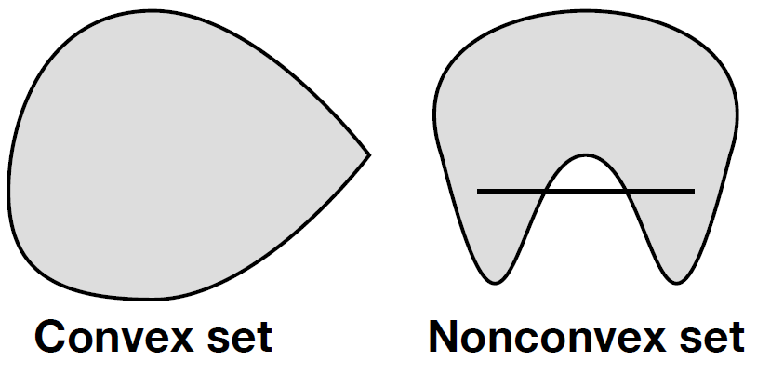
Convex Optimization: Definition
Convex Optimization Problem:
An optimization problem whose optimization objective $f$ is a convex function and feasible region $ℱ$is a convex set
A special class of optimization problem
$$\min_{x}{f(x)}$$
s.t. $x∈ℱ$
Notes:
Intuitively, convex means the shape of it curve outwards. A convex set in a 2-D space is a shape whose surface has no indentations. A convex function is one whose shape bends up. Draw examples

Slide 16
Convex Optimization: Definition
Convex combination
A point between two points
Given $x,y∈ℝ^{n}$, a convex combination of them is any point of the form $z=θx+\left(1−θ\right)y$ where $θ∈[0,1]$
When $θ∈(0,1)$, $z$ is called a strict convex combination of $x,y$
$$x$$
$$z$$
$$y$$

Slide 17
Convex Optimization: Definition
Convex set
Any convex combination of two points in the set is also in the set
A set $ℱ$ is convex if $∀x,y∈ℱ$, $∀θ∈\left[0,1\right]$,
$$z=θx+\left(1−θ\right)y∈ℱ$$

Slide 18
Quiz 1: Convex Set
Which of the following sets are convex?
A: $ℱ=ℝ^{n}$
B: $ℱ=∅$
C: $ℱ=\left\{x_{0}\right\},x_{0}∈ℝ^{n}$
D: $ℱ=ℱ_{1}∩ℱ_{2}$, where $ℱ_{1}$ and $ℱ_{2}$ are convex sets
E: $ℱ=ℱ_{1}∪ℱ_{2}\text{, }\text{where} ℱ_{1} \text{and} ℱ_{2} \text{are} \text{convex} \text{sets}$
Notes:
A, B, C, D

Slide 19
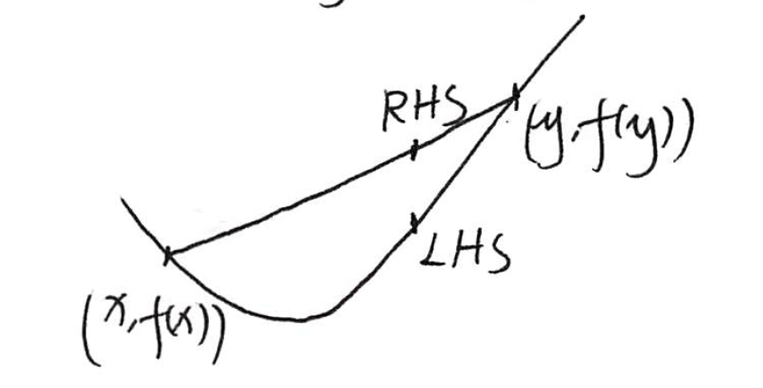
Convex Optimization: Definition
Convex function
Value in the middle point is lower than average value
Let $ℱ$be a convex set. A function $f:ℱ→ℝ$ is convex in $ℱ$if $∀x,y∈ℱ$,$∀θ∈\left[0,1\right],$
$$f\left(θx+\left(1−θ\right)y\right)≤θf\left(x\right)+\left(1−θ\right)f(y)$$
If $ℱ=ℝ^{n}$, we simply say $f$ is convex
Notes:
(Chords lie above the function)
Draw a plot

Slide 20
Convex Optimization: Definition
How to determine if a functions is convex?
Prove by definition
Use properties
Sum of convex functions is convex
If $f\left(x\right)=\sum_{i}{w_{i}f_{i}\left(x\right)},w_{i}≥0,f_{i}\left(x\right)$ convex, then $f(x)$ is convex
Convexity is preserved under a linear transformation
If $f\left(x\right)=g(Ax+b)$, $g$ convex, then $f(x)$ is convex
If $f$ is a twice differentiable function of one variable, $f$ is convex on an interval $\left[a,b\right]⊂ℝ$ iff (if and only if) its second derivative $f^{′′}\left(x\right)≥0$ in $\left[a,b\right]$

Slide 21
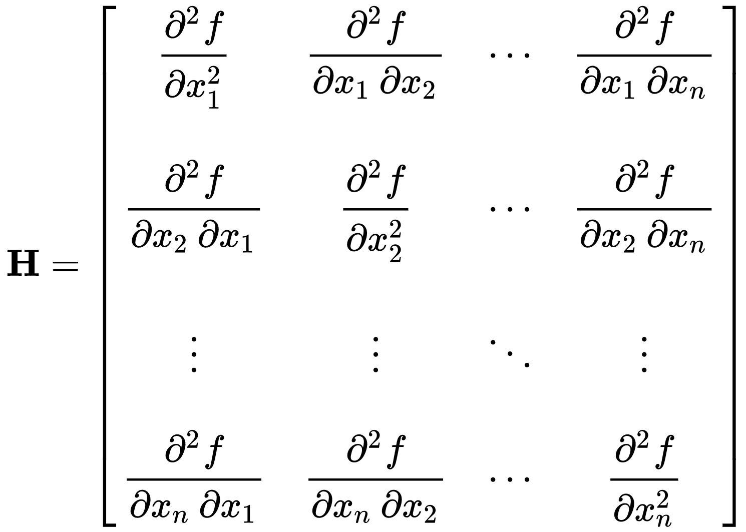
Convex Optimization: Definition
(not required) If $f$ is a twice continuously differentiable function of $n$ variables, $f$ is convex on $ℱ$ iff its Hessian matrix of second partial derivatives is positive semidefinite on the interior of $ℱ$
$H$ is positive semidefinite in $S$ if $∀x∈S$, $∀z∈ℝ^{n}, z^{T}H(x)z≥0$
$H$ is positive semidefinite in $ℝ^{n}$ iff all eigenvalues of $H$ are non-negative
Alternatively, prove $z^{T}H\left(x\right)z=\sum_{i}{{\left(g_{i}\left(x,z\right)\right)}^{2}}$

Slide 22
Convex Optimization: Definition
Concave function
A function $f$ is concave if $−f$ is convex
Let $ℱ$be a convex set. A function $f:ℱ→ℝ$ is concave in $ℱ$if $∀x,y∈ℱ$,$∀θ∈\left[0,1\right],$
$$f\left(θx+\left(1−θ\right)y\right)≥θf\left(x\right)+\left(1−θ\right)f\left(y\right)$$
The following is a convex optimization problem if $f$ is a concave function and $ℱ$ is a convex set
$$\max_{x}{f(x)}$$
s.t. $x∈ℱ$

Slide 23
Convex Optimization: Definition
Affine function
An affine function is a function of the form $f\left(x\right)=a^{T}x+b$ where $a∈ℝ^{n},b∈ℝ$
If a function $f$ is both convex and concave in $ℝ^{n}$, then $f$ is an affine function
Proof (not required):
Let $g\left(x\right)=f\left(x\right)−f(0)$.
Clearly $g(x)$ is convex and concave.
By definition, $g(x)$ satisfies (i) $g\left(x+y\right)=g\left(x\right)+g(y)$; (ii) $g\left(θx\right)=θg(x)$.
Let ${\left\{e_{j}\right\}}_{1}^{n}$ be the canonical basis of $ℝ^{n}$, then $x=\sum_{j}{x_{j}e_{j}}$.
Therefore $g\left(x\right)=\sum_{j}{x_{j}g(e_{j})}=a^{T}x$ where $a_{j}=g(e_{j})$.
So $f\left(x\right)=g\left(x\right)+f\left(0\right)=a^{T}x+b$
Notes:
Let $g\left(x\right)=f\left(x\right)−f(0)$. Clearly $g(x)$ is convex and concave. By definition, $g(x)$ satisfies (i) $g\left(x+y\right)=g\left(x\right)+g(y)$; (ii) $g\left(θx\right)=θg(x)$. Let ${\left\{e_{j}\right\}}_{1}^{n}$ be the canonical basis of $ℝ^{n}$, then $x=\sum_{j}{x_{j}e_{j}}$. Therefore $g\left(x\right)=\sum_{j}{x_{j}g(e_{j})}=a^{T}x$ where $a_{j}=g(e_{j})$. So $f\left(x\right)=g\left(x\right)+f\left(0\right)=a^{T}x+b$

Slide 24
Quiz 2: Convex Function
Which of the following functions are convex?
A: $f\left(x\right)=e^{ax},a∈ℝ$
B: $f\left(x\right)=\log{x},x∈(0,+∞)$
C: $f\left(x\right)={\left\|x\right\|}_{2}=\sqrt{\sum_{i}{x_{i}^{2}}}$
D: $f\left(x,y\right)=x^{T}Ay, A∈ℝ^{m×n},x∈ℝ^{m},y∈ℝ^{n}$
E: $f\left(x\right)=x^{3},x∈ℝ$
Counter Example for D:$x,y∈ℝ$, $A=−1$, $f\left(x,y\right)=−xy$. $f\left(−1,−1\right)=f\left(1,1\right)=−1$, $f\left(0,0\right)=0$
http://m.wolframalpha.com/input/?i=z%3D-xy
Notes:
A, B, C
Counter Example for D:$x,y∈ℝ$, $A=−1$, $f\left(x,y\right)=−xy$. $f\left(−1,−1\right)=f\left(1,1\right)=−1$, $f\left(0,0\right)=0$

Slide 25
Convex Optimization: Local Optima=Global Optima
Given an optimization problem, a point $x∈ℝ^{n}$ is globally optimal if $x∈ℱ$ and $∀y∈ℱ,f\left(x\right)≤f\left(y\right)$
Given an optimization problem, a point $x∈ℝ^{n}$ is locally optimal if $x∈ℱ$ and $∃R>0$ such that $∀y:y∈ℱ$ and ${\left\|x−y\right\|}_{2}≤R,f\left(x\right)≤f\left(y\right)$
Theorem 1: For a convex optimization problem, all locally optimal points are globally optimal
$$\min_{x}{f(x)}$$
s.t. $x∈ℱ$
Notes:
Key property: all local optima are global optima

Slide 26
Convex Optimization: Local Optima=Global Optima
Proof of Theorem 1: Prove by contradiction.
Assume $x$ is a local optima with optimality radius $R$, and $∃y∈ℱ,f\left(x\right)>f\left(y\right)$. Let $z=θx+\left(1−θ\right)y$ where $θ=1−\frac{R}{2{\left\|x−y\right\|}_{2}}$.
(1) $z∈ℱ$ due to convexity of $ℱ$
(2) ${\left\|x−z\right\|}_{2}={\left\|x−θx−\left(1−θ\right)y\right\|}_{2}=\left(1−θ\right){\left\|x−y\right\|}_{2}$
$$=\frac{R}{2{\left\|x−y\right\|}_{2}}{\left\|x−y\right\|}_{2}=\frac{R}{2}≤R$$
(3) $f\left(z\right)≤θf\left(x\right)+\left(1−θ\right)f\left(y\right)<θf\left(x\right)+\left(1−θ\right)f\left(x\right)=f\left(x\right)$
So $x$ is not local optima. Contradiction.
Notes:
Assume $x$ is a local optima with optimality radius $R$, and $∃y∈ℱ,f\left(x\right)>f\left(y\right)$. Let $z=θx+\left(1−θ\right)y$ where $θ=1−\frac{R}{2{\left\|x−y\right\|}_{2}}$.
(1) $z∈ℱ$ due to convexity of $ℱ$
(2) ${\left\|x−z\right\|}_{2}={\left\|x−θx−\left(1−θ\right)y\right\|}_{2}=\left(1−θ\right){\left\|x−y\right\|}_{2}$
$$=\frac{R}{2{\left\|x−y\right\|}_{2}}{\left\|x−y\right\|}_{2}=\frac{R}{2}≤R$$
(3) $f\left(z\right)≤θf\left(x\right)+\left(1−θ\right)f\left(y\right)<θf\left(x\right)+\left(1−θ\right)f\left(x\right)=f\left(x\right)$
So $x$ is not local optima. Contradiction.

Slide 27
Convex Optimization: How to Solve
Recall discrete setting
Local search
Iteratively improving an assignment
Continuous and differentiable setting
Iteratively improving value of $x$
Based on gradient

Slide 28
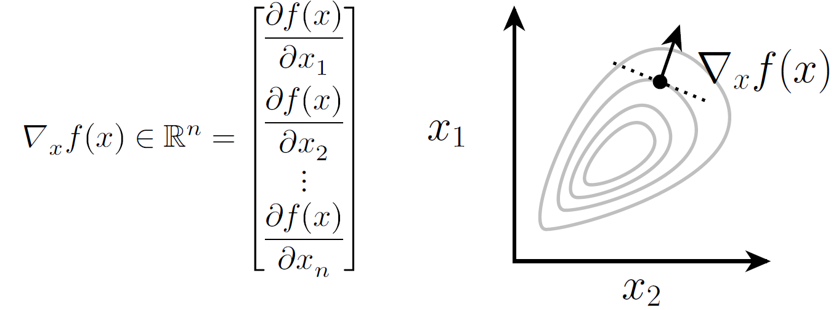
Convex Optimization: How to Solve
For $f:ℝ^{n}→ℝ$, gradient is the vector of partial derivatives
A multi-variable generalization of the derivative
Point in the direction of steepest increase in $f$

Slide 29
Convex Optimization: How to Solve
Gradient descent: iteratively update the value of $x$
A simple algorithm for unconstrained optimization $\min_{x∈ℝ^{n}}{f(x)}$
Variants
How to choose $x_{0}$, e.g., $x_{0}=0$
How to update $α$, e.g., $α^{i+1}=\frac{{\left(x^{i+1}−x^{i}\right)}^{T}(∇_{x}f\left(x^{i+1}\right)−∇_{x}f\left(x^{i}\right))}{{\left\|∇_{x}f\left(x^{i+1}\right)−∇_{x}f\left(x^{i}\right)\right\|}_{2}^{2}}$
How to define “convergence”, e.g., ${\left\|x^{i+1}−x^{i}\right\|}_{2}≤ε$
Algorithm: Gradient Descent
Input: function $f$, initial point $x_{0}$, step size $α>0$
Initialize $x←x_{0}$ Repeat $x←x−α∇_{x}f\left(x\right)$ Until convergence
Notes:
Draw a figure for 1-D case and 2-D case

Slide 30
Convex Optimization: How to Solve
Theorem 2: For differentiable $f$ and small enough $α$, for any $x$ with $∇_{x}f\left(x\right)≠0$, $f\left(x−α∇_{x}f\left(x\right)\right)<f\left(x\right)$
$f$ can be convex or non-convex
(Informal) For convex and differentiable $f$ and small enough $α$, gradient descent converges to global optimum
Proof (not required):
(Recall Taylor expansion $f\left(x+δ\right)=f\left(x\right)+∇_{x}f{\left(x\right)}^{T}δ+O({\left\|δ\right\|}_{2}^{2})$)
Consider a small $α$, use Taylor expansion
$$f\left(x−α∇_{x}f\left(x\right)\right)=f\left(x\right)+∇_{x}f{\left(x\right)}^{T}\left(−α∇_{x}f\left(x\right)\right)+O\left({\left\|−α∇_{x}f\left(x\right)\right\|}_{2}^{2}\right) \\ =f\left(x\right)−α{\left\|∇_{x}f\left(x\right)\right\|}_{2}^{2}+O\left({\left\|α∇_{x}f\left(x\right)\right\|}_{2}^{2}\right) \\ ≤f\left(x\right)−α{\left\|∇_{x}f\left(x\right)\right\|}_{2}^{2}+Cα^{2}{\left\|∇_{x}f\left(x\right)\right\|}_{2}^{2} \\ <f(x)$$
Last inequality holds for $α<\frac{1}{C}$ since ${\left\|∇_{x}f\left(x\right)\right\|}_{2}^{2}>0$

Slide 31
Convex Optimization: How to Solve
Projected Gradient Descent: iteratively update the value of $x$ while ensuring $x∈ℱ$
$P_{ℱ}$ projects a point to the constraint set
Variants
How to choose $P_{ℱ}$, e.g., $P_{ℱ}(x)=\underset{x^{′}∈ℱ}{argmin}{{\left\|x−x^{′}\right\|}_{2}^{2}}$
Algorithm: Projected Gradient Descent
Input: function $f$, initial point $x_{0}$, step size $α>0$
Initialize $x←x_{0}$ Repeat $x←P_{ℱ}(x−α∇_{x}f\left(x\right))$ Until convergence
Notes:
Draw a figure for 1-D case and 2-D case

Slide 32
Convex Optimization: How to Solve
Unconstrained and differentiable
Gradient descent
Set derivative to be 0
Closed form solution
(Not covered) Newton’s Method (if twice differentiable)
Constrained and differentiable
Projected gradient descent
(Not covered) Interior Point Method
(Not covered) Non-differentiable
$ε$-Subgradient Method
Cutting Plane Method

Slide 33
Convex Optimization: Apply
Model a problem as a convex optimization problem
Define variable, feasible set, objective function
Prove it is convex (convex function + convex set)
Solve the convex optimization problem
Build up the model
Call a solver
Examples: fmincon (MATLAB), cvxpy (Python), cvxopt (Python), cvx (MATLAB)
Map the solution back to the original problem

Slide 34
Summary
Optimization Problems
Convex Programs
Gradient Descent

Slide 35
Convex Optimization: Additional Resources
Text book
Convex Optimization, Chapters 1-4 Stephen Boyd and Lieven Vandenberghe Cambridge University Press https://web.stanford.edu/~boyd/cvxbook/
Online course
Stanford University, Convex Optimization I (EE 364A), taught by Stephen Boyd
http://ee364a.stanford.edu/courseinfo.html
https://youtu.be/McLq1hEq3UY

Slide 36
Acknowledgment
Some slides are borrowed from previous slides made by J. Zico Kolter

